Slide 1
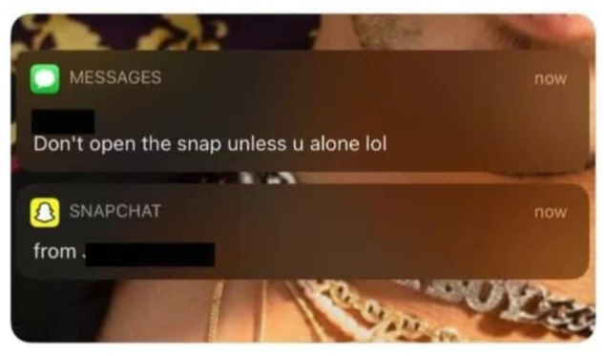
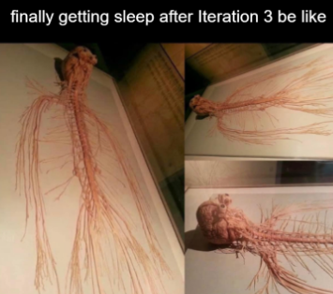

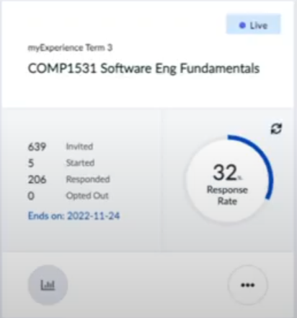
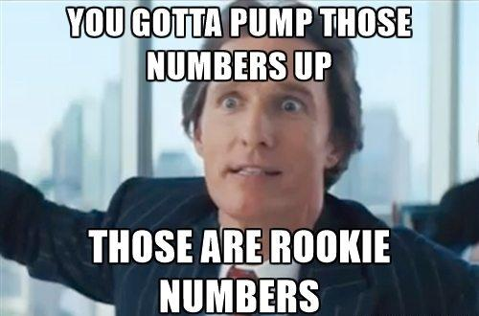

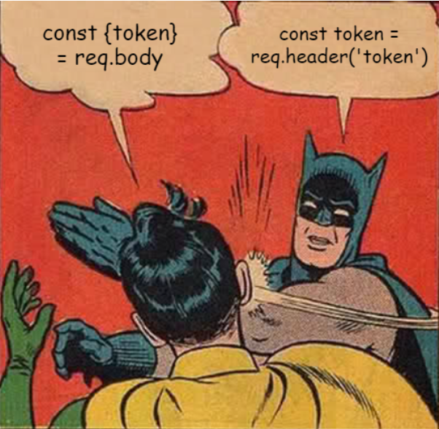
COMP1531 | T09B / H17B Week 10
Hayden Smith
Hayden Smith
william.huynh3@unsw.edu.au

Slide 2
Learning objectives
myExperience surveys
Exam Info
Revision Kahoot

Slide 3

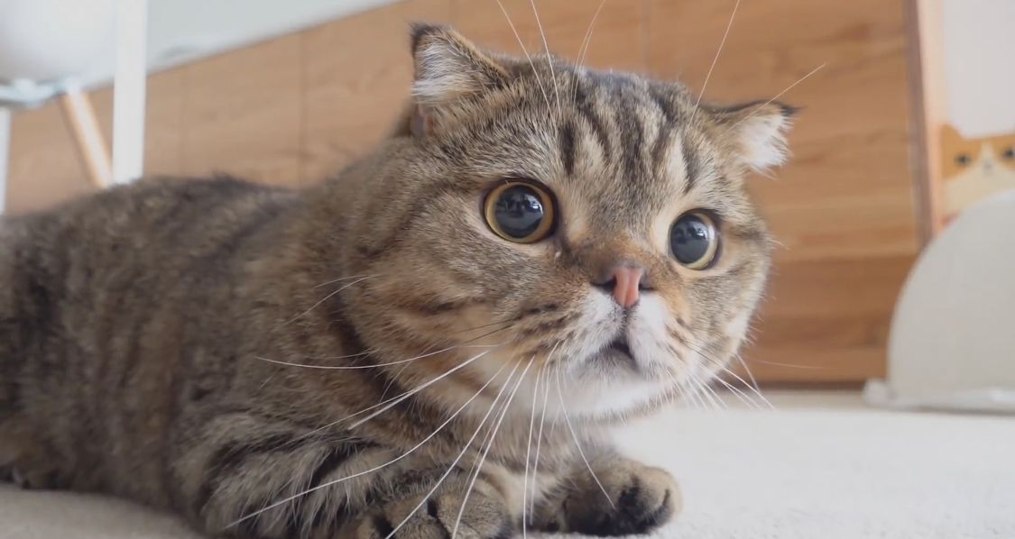
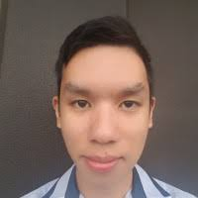

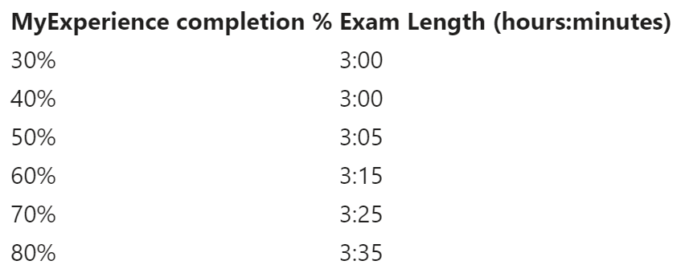
For every % over 50%, there will be an extra minute added to the exam !!
Pls do it :3

Slide 4
Exam Key Info
The final exam will be a 3 hour exam that begins at 2pm and finishes at 5pm.
The exam takes place on the 28th of November and is worth 30%
Short Answer Questions (15%)
Similar to tute questions
All short written questions, there will be no diagram questions
Programming Questions (85%)
Similar to lab questions
Some may be HTTP based questions (Express & server.ts)
You will be expected to write JEST tests (not HTTP tests), and have high coverage

Slide 5


Key Topics
TypeScript
HTTP - Writing API routes
Objects & Arrays
General Programming

Slide 6
Kahoot
https://play.kahoot.it/v2/?quizId=396aa8da-902a-4955-a56d-2a29c6ca1faa

